Slide 1
Outcomes-Based Arrangements:
Access to Transformative Therapies
April 25, 2023
Sponsored by BioMarin
This material was presented on 04/25/23; its continued accuracy, reliability, correctness, or completeness cannot not be assured after that date.
MMRC-NOP-00185 / April 2023

Slide 2
What We’ll Cover Today
Introduce Rare & Ready: A Genetic Condition Coalition
Provide a greater understanding of the current landscape for outcomes-based arrangements (OBAs)
Explore the policy barriers to OBAs
Talk about what state Medicaid programs can do to adopt OBAs as well as proposed federal legislation
Propose ways you can get involved

Slide 3
RARE & READY: A GENETIC CONDITION COALITION
Kari Lato
Sr. Director, Policy & Advocacy
Rx4good

Slide 4
46 Members of the Rare & Ready Coalition

Slide 5
Power of a Coalition
Rare & Ready
Influence public policy
Pool and leverage resources for greater impact
Coordinate efforts more effectively and efficiently
Targeted effort on Medicaid access for the rare disease community

Slide 6
Focused on Three Policy Priorities
Patients with rare or genetic conditions deserve access to new FDA-approved therapies as soon as they are available. We need to mitigate state Medicaid program hurdles that limit access.
Telehealth across state lines helps ensure accurate diagnosis, good disease management, and access to the small number of rare disease experts.
Outcomes-based arrangements offer hope for those with rare conditions to access transformative treatments including gene and cell therapies.

Slide 7
CAMPAIGN FOR TRANSFORMATIVE THERAPIES (CTT)
Sloan Salzburg
Vice President Council for Affordable Health Coverage Campaign for Transformative Therapies

Slide 8
Update

Slide 9
About CAHC and CTT
Patient
Biopharma
Payer
Employer
Tech/Broker
The Council for Affordable Health Coverage (CAHC) members believe that the cost of health coverage is too high and growing too fast. CAHC promotes policies that lower health costs through increased competition, informed consumers, and more choices to help promote access to affordable coverage.
CAHC launched the Campaign for Transformative Therapies (CTT) to unite payers, manufacturers, and patients around policies that improve access to and lowers the cost of gene therapies.

Slide 10
Value-Based Payment Arrangements 101
VBPs tie reimbursement to outcomes (i.e., did the drug do what it was supposed to?)
VBPs can base outcomes on:
Clinical circumstances, patient outcomes, or other measures
The reimbursement structure can vary:
Rebates/refunds/repayments, paying directly for a service, etc.
Also Known As (AKA):
Outcomes-based arrangements
Pay-for-performance
Innovative payment arrangements
Alternative payment arrangements
Contract: Set clear definition of terms and goals for patient populations
Reporting: Establish how the data will be collected
Payment: Reimburse based on outcomes
Data Analysis: Calculate based on reported data to provide accurate reimbursement

Slide 11
Why Is this Important for Patients with Rare Disorders?
Value-based payment arrangements improve patient access to innovative therapies by reducing cost and risk for health plans/Medicaid programs
VBPs reduce wasteful spending by targeting the right drug to the right patient and refocusing spending on drugs that actually work
VBPs increase patient access by mitigating risk and costs borne by payers

Slide 12
VBPs: A Sustainable Financing Model for Transformative Therapies
Payer
Commercial/Private
Federal
Medicaid
Medicare
Insurers negotiate with manufacturers for each Rx that has a VBP
Need: Policy clarification that refunds for non-responders do not count toward cumulative discounts to federal programs
Multiple Best Price pathway enabled by a CMS rule
State Plan Amendment (SPA) – waiver for states to individually negotiate with manufacturers around specific Rx
Legislation – sometimes needed to submit a SPA
TBD: CMMI Cell and Gene Therapy Demonstration
Manufacturers negotiate with prescription drug purchasers around specific Rx VBPs
Need: Policy clarification that refunds do not count toward AKS
Need: Policy clarification that refunds do not count toward Anti-Kickback Statute (AKS)

Slide 13
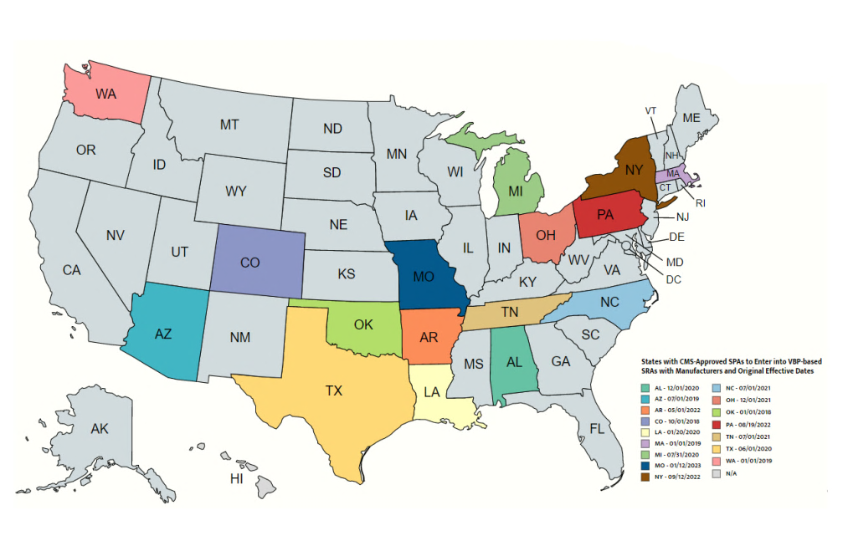
State Activities re: VBPs
16 States have State Plan Amendments (SPA) authorizing them to enter into VBPs with manufacturers for Medicaid drugs

Slide 14
Federal Activity
Medicaid VBPs for Patients (MVP) Act –H.R. 2666 Supplements a CMS Rule to facilitate VBPs to public and private payers by adding clarifications
Center for Medicare and Medicaid Innovation (CMMI) Demonstration – Cell and Gene Therapy Access Model TBD – Medicaid-focused model that would establish a centralized process to facilitate VBPs for “certain” cell and gene therapies

Slide 15
What can you do?
Talk to Medicaid plan officials about gene therapies and access issues – how VBPs will help solve patient access/budgetary concerns
Advocate with state and/or federal legislators

Slide 16
Questions?
Sloane Salzburg
Vice President
Sloane.salzburg@cahc.net
Council for Affordable Health Coverage
Campaign for Transformative Therapies
cahc.net | @C4AHC

Slide 17
HOW TO GET INVOLVED
Kari Lato
Sr. Director, Policy & Advocacy
Rx4good

Slide 18
Principles for Advocating Change
Three steps for policy change:
Build a strong and diverse coalition to amplify your voice and impact.
Create awareness, influence public perception, and move people to action.
Educate and engage policymakers and other stakeholders.

Slide 19
Effective Ways to Advocate
Join the Rare & Ready Coalition and encourage others to join the coalition. The more voices – the bigger the impact!
Meet with decision-makers to share your rare disease experience. Explain the impact of their policy decisions on your community.
Write an op-ed or letter to the editor.
Use social media to educate and bring awareness to the issue – make sure to tag and include relevant hashtags.
Submit comments or feedback on policies and regulations.
Attend conferences, trainings, forums, and events.
Tap into e-advocacy, sign up for newsletters and e-alerts.

Slide 20
Communicating with Legislators
Introduce yourself and the Rare & Ready Coalition through written communications.
Find template letters and contact information at: www.rareandready.org/take-action/.
Follow-up with a phone call or personal visit.
Follow and tag your legislator on social media.

Slide 21
Leveraging Social Media
#Hashtag your way into the conversation.
Keep up with legislative movements.
Follow @rare_ready and share tweets.
Use Facebook Groups to spread the word.
Share messages from the Rare & Ready Coalition.
Share responses from elected officials.
Let pictures/videos tell the story.
Instagram can paint a picture that emails can’t.
Use videos to tell your rare disease experience.

Slide 22
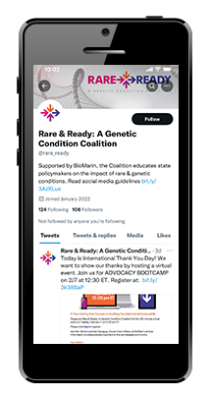
Other Ways You Can Help
Join the Coalition
Contact kari.lato@rx4good.com to join
Ask others to join
Share Your Experience
Share your story on www.rareandready.org
Meet with decision-makers
Use Social Media
Follow @rare_ready
Repost on your social media channels

