Slide 1
ADVOCACY BOOTCAMP
February 7, 2023
Sponsored by BioMarin
This material was presented on 02/07/23; its continued accuracy, reliability, correctness, or completeness cannot not be assured after that date.
MMRC-NOP-00160 / January 2023

Slide 2
What We’ll Cover Today
Rare & Ready: A Genetic Condition Coalition
Medicaid Access to Treatments for Rare Conditions
Improving Access to Telehealth
How to Get Involved

Slide 3
Have you ever communicated with your state or federal legislator?
Yes
No

Slide 4
Rare & Ready: A Genetic Condition Coalition
Kari Lato
Sr. Director, Policy & Advocacy
Rx4good

Slide 5
Rare & Ready: A Genetic Condition Coalition

Slide 6
Power of a Coalition
Rare & Ready
Influence public policy
Pool and leverage resources for greater impact
Coordinate efforts more effectively and efficiently
Targeted effort on Medicaid access for the rare disease community

Slide 7
Focused on Three Policy Priorities
Patients with rare or genetic conditions deserve access to new FDA-approved therapies as soon as they are available. We need to mitigate state Medicaid program hurdles that limit access.
Outcomes-based arrangements offer hope for those with rare conditions to access transformative treatments including gene and cell therapies.
Telehealth across state lines helps ensure accurate diagnosis, good disease management, and access to the small number of rare disease experts.

Slide 8
MEDICAID ACCESS TO TREATMENTS FOR RARE CONDITIONS
Ken Sprague
Associate Director, Government Affairs BioMarin

Slide 9
Challenges in Accessing Rare Disease Therapies
ICER and Other Cost-Effectiveness Analysis
State Medicaid Agencies Lack of Coverage
Price Controls
State Medicaid agencies rely on the Institute for Clinical & Economic Review (ICER) analyses and reports to evaluate treatments.
Disproportionate impact on rare disease therapies because of the use of quality-adjusted life-year (QALY).
Medicaid agencies (CA, MA) working directly with ICER or leveraging reports when developing coverage criteria.
State Medicaid agencies may use waivers and other avenues to limit access to innovative therapies.
Operating a commercial-style closed formulary or not covering accelerated approval drugs have become more commonplace.
While some proposals haven’t been approved by the Centers for Medicare and Medicaid Services, more continue to “pop up.”
Price setting through prescription drug affordability boards or reference pricing legislation is a common tactic used by state Medicaid agencies.
Laws/proposed legislation allow states to limit reimbursement levels for certain innovative therapies.
These laws are an existential threat to the innovative R&D pipeline for rare disease therapies.

Slide 10
Hurdles Impede Access to Treatments
Several “operational hurdles” pose a threat to rare disease therapy access
Significant delays to meaningful coverage in Medicaid upon FDA-approval
Medicaid coverage criteria being more restrictive than the FDA-approved label
Discrepancies between managed care coverage criteria and fee-for-service

Slide 11
“Time to Treat” Legislative Concept & Principles
Mandated time frame for completion of clinical review and development/publishing of coverage criteria
Coverage policy developed cannot be more restrictive than the indications and usage section of FDA-approved label
Easy exception process for step therapy if deemed medically necessary by provider – creates a straightforward exceptions process - mandates response to request within 72 hours for request, 24 hours for emergency request
Defines “qualifying rare disease therapy” as rare pediatric therapy, orphan therapy, breakthrough or Regenerative Medicine Advanced Therapy designation
Prevents lengthy delays to development of coverage policies
Rationale
Prevents Medicaid/managed care organizations from developing coverage policy based on trial inclusion/exclusion criteria
Rationale
Helps mitigate some of the onerous utilization management strategies implemented by plans and Medicaid
Rationale
Limits scope of legislation to increase likelihood of passage
Rationale

Slide 12
Do you have the enough information to talk with state policymakers about Medicaid access challenges faced by people with rare disorders?
Yes
Somewhat
No

Slide 13
Questions

Slide 14
INTERSTATE TELEHEALTH
Jennifer Hitchon
Director, Government Affairs BioMarin

Slide 15
Telehealth Landscape
Responding to the public health emergency, all 50 states and DC waived – to varying extents – state licensure laws in order to facilitate telehealth across state lines.
Now 40 states and DC (and counting) have now ended their emergency declarations, and many of the telehealth and licensure flexibilities are expiring with them.
No uniformity: The coverage and reimbursement rules around telehealth visits vary by state and by payer (Medicaid, commercial insurance, employer health plans).
No clarity: Many telehealth policies are not written down and not publicly available. Some are only made on an ad hoc, case-by-case basis, so it is difficult for patients and physicians to know in advance what care will be covered.

Slide 16
Why Interstate Telehealth is Uniquely Important for Rare Disease Patients
With a limited number of medical experts in their rare conditions, access to telehealth across state lines can be critical for good disease management for patients with rare conditions.
This is especially true as travel for rare disease patients and their caregivers can be uniquely complex.
In addition to patient need, in-state physicians are asking for virtual consults with out of state rare disease physician colleagues to be covered.
We recognize that telehealth has its limitations. Virtual care should not replace necessary in-person visits. That is not good health care, and not good policy.
There is a need for clear, defined pathways to patient access and payer reimbursement

Slide 17
Have you or a loved one experienced challenges getting access to out-of-state telehealth visits?
Yes
Somewhat
No

Slide 18
Hurdles to State-by-State Licensure Exceptions
Physician pushback
(Misplaced) concerns about limiting access to in-person visits

Slide 19
Policy Pathways for Access
Reciprocity
Federal legislative path
Unsuccessful thus far
Compact (IMLC)
Most states members
Rare Disease Licensure Exception
States should adopt licensure exceptions for out-of-state physicians treating patients with rare disorders via telehealth
Arguably onerous

Slide 20
Questions

Slide 21
EFFECTIVE ADVOCACY
Kari Lato
Sr. Director, Policy & Advocacy
Rx4good

Slide 22
Why Advocacy Matters
Gives a voice to those most impacted by policy decisions.
Increases awareness to initiate changes that create better outcomes.
Serves as a powerful tool for raising disease awareness and offering valuable insight into the patient and caregiver experience.
Messages delivered through storytelling are 22 times more memorable than facts.¹
1: A Good Presentation Is About Data And Story. Forbes. 2015. https://bit.ly/3IjJQL0. Accessed on 3/12/22.

Slide 23
Principles for Advocating Change
Three steps for policy change:
Create awareness, influence public perception, and move people to action.
Educate and engage policymakers and other stakeholders.
Build a strong and diverse coalition to amplify your voice and impact.

Slide 24
Effective Ways to Advocate
Join the Rare & Ready Coalition and encourage others to join the coalition. The more voices – the bigger the impact!
Meet with decision-makers to share your rare disease experience. Explain the impact of their policy decisions on your community.
Write an op-ed or letter to the editor.
Use social media to educate and bring awareness to the issue – make sure to tag and include relevant hashtags.
Submit comments or feedback on policies and regulations.
Attend conferences, trainings, forums, and events.
Tap into e-advocacy, sign up for newsletters and e-alerts.

Slide 25
Building and Communicating Your Message
Keep it simple. Focus on the facts and the impact of your disease and the urgency to act.
Share the problem. Offer a solution. Ask for what you need or what can help.
Be authentic. Create connections and empathy by being open and honest. Be willing to answer questions.
Inspire ACTION!

Slide 26
Create Your Elevator Pitch
What It Is
A brief (think 30-90 seconds) way of introducing your disease, sharing a few key points, and connecting with your audience.
Why It’s Important
Helps you get your audience’s attention.
Allows you to succinctly and briefly describe your disease journey.
Points to Consider
Avoid using acronyms and too much medical terminology.
Discuss the need. Combine facts with personal stories on why this is important.
Offer a solution or call to action.
Practice your elevator pitch so you can pivot to different audiences as needed.

Slide 27
Do you know why it is important to create an “elevator pitch” about policy issues?
Yes
Somewhat
No

Slide 28
Communicating with Legislators
Find state legislators at: https://www.rareandready.org/take-action/
Introduce yourself and the Rare & Ready Coalition through written communications.
Follow-up with a phone call or personal visit.
Follow and tag your legislator on social media.

Slide 29
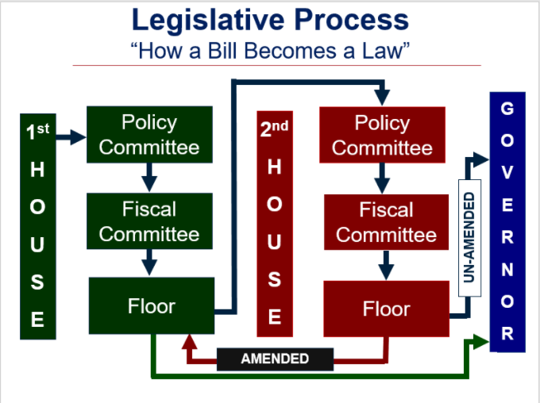
Image from https://southwestca.net/legislative-issues

Slide 30
Providing Testimony on Legislation
Be aware of and follow the committee’s rules for testimony.
Keep it simple, short, and focused. Avoid medical jargon and acronyms.
Clearly present your position: “I support” or “I oppose” followed by bill number and title.
Say why you have taken your position. Share your personal story.
Ask for specific action: “I urge you to vote in favor of…” or “against.”
Thank the committee for the opportunity to speak and offer to answer questions.
Type your testimony and make copies for legislators, include your contact information.

Slide 31
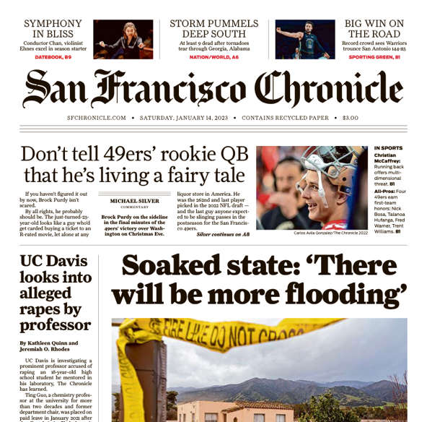
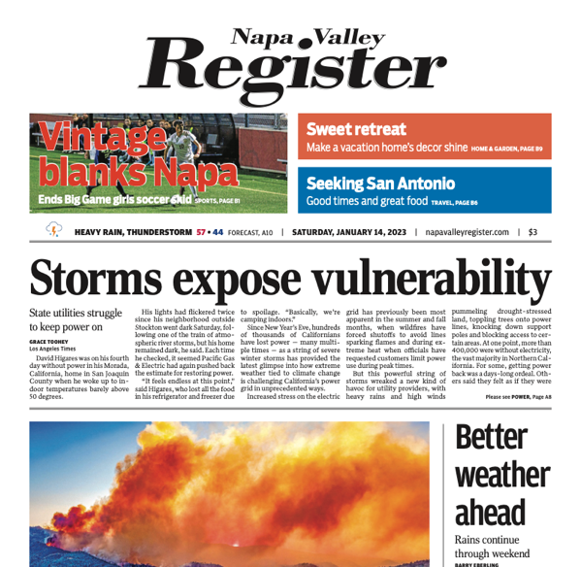
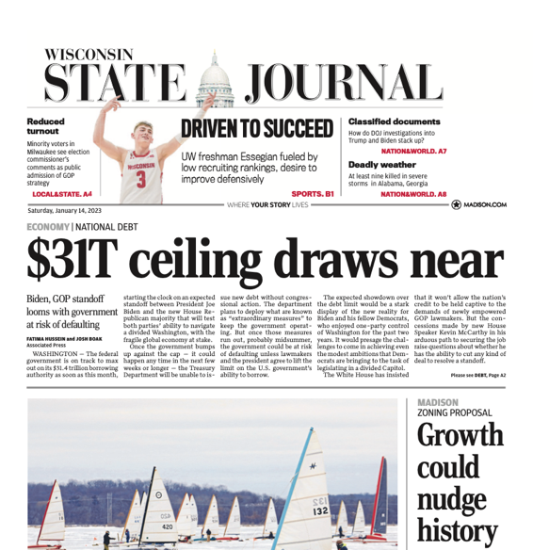
Submitting Letters to the Editor and Op-Eds
Letters to the Editor
Op-Eds
Between 150-300 words.
Grab the reader’s attention! Personal opening statements help establish credibility as someone with firsthand knowledge of the issue.
Stick to the facts.
End with a call to action.
Approximately 750 words.
An opportunity for people to promote their advocacy for a specific point of view on controversial issues.
Find the best outlet(s) that will reach your target audience.
Decide on your main point and open with a strong lead to hook your audience.
End with a call to action.
Select one paper to contact, and if your letter doesn’t get accepted by the first paper, continue to the next.

Slide 32
Leveraging Social Media
#Hashtag your way into the conversation.
Keep up with legislative movements.
Follow @rare_ready and share tweets.
Use Facebook Groups to spread the word.
Share messages from the Rare & Ready Coalition.
Share responses from elected officials.
Let pictures/videos tell the story.
Instagram can paint a picture that emails can’t.
Use videos to tell your rare disease experience.

Slide 33
Would you be comfortable using social and/or traditional media to bring awareness to policy issues or legislation?
Yes
Somewhat
No

Slide 34
Taking Initial Action
Go to https://www.rareandready.org/take-action/ and download template letters.
Customize and send letter to state legislators who serve on Committees of Jurisdiction and state RDAC (Rare Disease Advisory Council) members.
State policymaker contact information is provided.
Once you send letter, let me know!

Slide 35
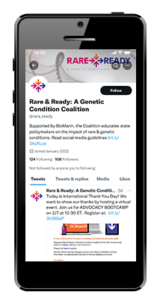
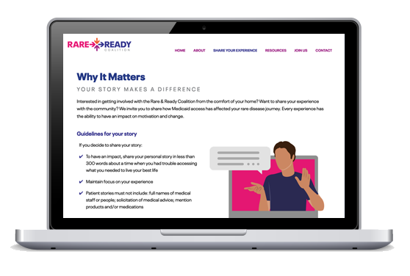
Other Ways You Can Help
Join the Coalition
Contact kari.lato@rx4good.com to join
Ask others to join
Share Your Experience
Share your story on www.rareandready.org
Meet with decision-makers
Use Social Media
Follow @rare_ready
Repost on your social media channels

Slide 36
Do you feel better prepared to advocate for rare disease policies?
Yes
Somewhat
No

